Slide 1
Single Payer Healthcare
Aka - Improved medicare for all
Notes:
Who knows

Slide 2

What is Single Payer?
Covers everyone, from birth to death
Comprehensive coverage, including payments to medical, preventive, dental, vision, hearing, long-term care, prescriptions, mental health, reproductive care
No cost-sharing (i.e. no co-payments, no premiums, no deductibles)
Paid for by one national payer, but care still provided by private institutions

Slide 3
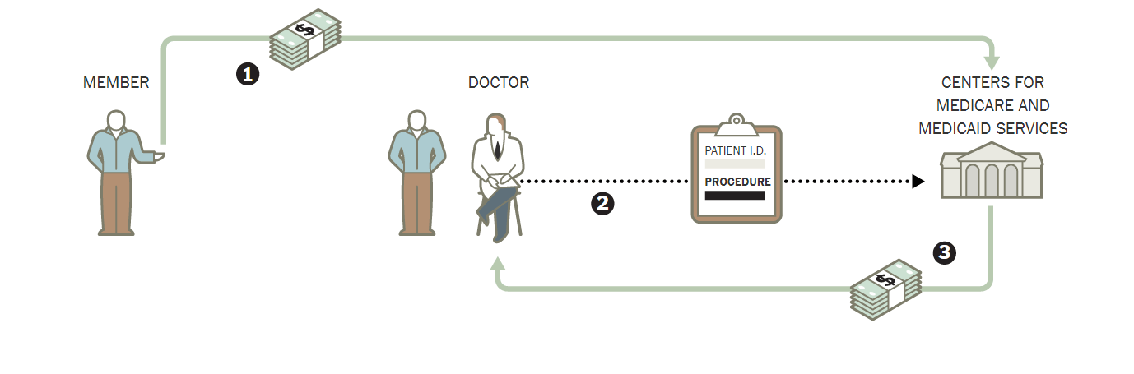
Single Payer: How it Works
Achoo!
Image adapted and revised from The New York Times,
from article written by M.W. Walsh.
Notes:
You, as a resident of the country, go to your doctor when you are sick.
You can go to any doctor you want as there are no provider networks anymore.
Your doctor treats you. Orders exams or prescriptions as they deem appropriate.
They then bill Medicare. They receive payment from Medicare within 2-4 weeks.
You go home, hopefully get better, and you DON’T RECEIVE A BILL. I repeat you don’t receive a bill.

Slide 4
Benefits of Single Payer (SP)
No medical bankruptcies
Healthcare not tied to employment, age, marital status
Lifts the burden of healthcare from employers & local municipalities
Freedom to get care anywhere
Care will be more equitable
Notes:
Reduce provider burn-out:
Providers are overloaded with paperwork.
Providers are limited in the care they can provide by insurance companies impacting their ability to treat patients.
No medical bankruptcies:
No surprise medical bills.
Won’t lose your home for getting sick.
Transparency:
The rules are the same for everyone. Currently, it’s impossible to know the rules of your insurance. It’s nearly impossible to know what should or shouldn’t be covered. And if you’re not happy with what your insurance tells you, you essentially have no recourse.
Under Medicare for All, if we don’t like one of the rules, we can change them!
Healthcare not tied to employment:
Can leave a job without worrying you’ll lose your coverage.
Don’t have to consider your health insurance when looking for a new job. You can just look at the actual job!
Lifts the burden of healthcare from employers:
Employers won’t have to waste time and resources trying to find appropriate insurance plans for their employees.
Wages or revenues can increase as employers don’t have to pay for healthcare.
Freedom to get care for you and your loved ones.

Slide 5
Medicare Under Threat of Privatization

Slide 6
Medicare Today
Traditional Medicare: publicly run, most efficient
Medicare Advantage: Privatized, inefficient
Medicare Direct Contracting Entities (DCEs Ended 2022)
ACO REACH – Privatizing TM (Accountable Care Organizations: Realizing Equity, Access, and Community Health) Begun Jan 2023

Slide 7
The Medicare Pie Before 2003
Source: https://www.cms.gov/Research-Statistics-Data-and-Systems/Statistics-Trends-and-Reports/Archives/MMSS and https://www.kff.org/medicare/
state-indicator/total-medicare-beneficiaries/?currentTimeframe=0&sortModel=%7B%22colId%22:%22Location%22,%22sort%22:%22asc%22%7D

Slide 8
The Medicare Pie Today
Total 2021:$926 Billion

Slide 9
Medicare Advantage, Highly Profitable
Annual Gross Margins for MA per person were double the margins in the individual and group markets, 2016 – 2018:
  Medicare Advantage Margins: $1,608
  Individual Market: $779
  Group (employer) Market: $855
Source: Kaiser Family Foundation
Notes:
Is Medicare Advantage better? Multiple studies have been done in the last 10 years and have not shown improvement

Slide 10
Contributing to MA Profits, Fraud
8/10 biggest MA insurers (>2/3 of the market) have submitted inflated bills
4/5 of the largest players (UH, Humana, Elevance (Anthem), &Kaiser) have faced federal lawsuits alleging fraud through upcoding
$12-25 billion in overpayments in 2020
April 2022 CMS and the Biden Administration hiked rates for MA plans by 8.5%
Source:National Single Payer Healthcare

Slide 11
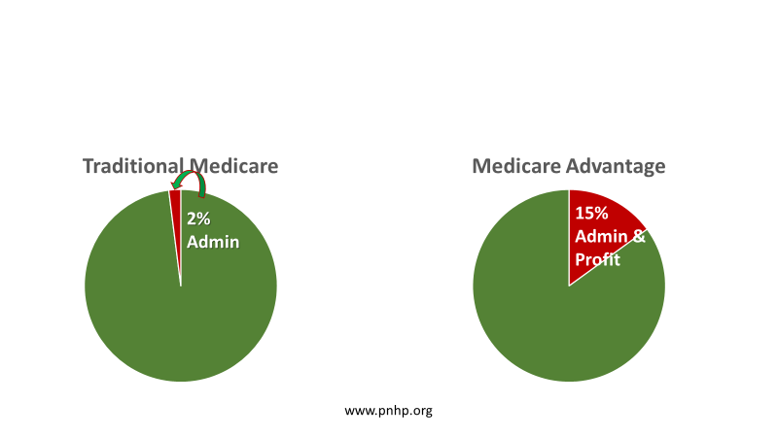
Medicare Advantage Increased Administrative Costs: More to admistrators, Less to Patients

Slide 12
Is Medicare Advantage “Better”?
Does Medicare Advantage provide better outcomes?
  JAMA 12-6-22: very little difference between outcomes for acute MI for MA vs TM
Encounter data (MedPAC report)
  Efforts to collect encounter data started in 1997; CMS began collecting encounter data for MA in 2012
  Encounter data important for the oversight of Medicare
    $350 B spent on MA in 2021
    Little understanding of service use
    $10-$11 B in quality bonus payments but quality data are not meaningful
    Little visibility into ~$50 B in spending on extra benefits
  Plans have incentive to only submit data that contributes to RS, not complete data
  MedPAC found that 2014-2017 ED were incomplete and recommended steps to improve completeness and accuracy
Source: Medicare Advantage Encounter Data Sept 2021; Medicare Payment Advisory Commission Sample title here (medpac.gov)
Source: Bruce Landon, et el. Association of MA vs TM With 30-Day Mortality Among Patients with Acute MI, JAMA, Dec 6, 2022
Notes:
Is Medicare Advantage better? Multiple studies have been done in the last 10 years and have not shown improvement

Slide 13
ACO REACH
Moves all TM enrollees into HMOs owned by private investors
DCE can be started by anyone, no knowledge of health care required.
  Insurance companies, private equity firms, individual wealthy investors, Jeff Bezos
  Paid like MA. DCEs can keep up to 40% as profit & overhead
  Creates dangerous incentive to ration and restrict care for seniors and the disabled on TM
Source: PHNP
Notes:
What’s happening is people in traditional Medicare will be switched to ACO Reach without their consent or knowledge simply because your PCP is part of an ACO Reach. Patients have no say whatsoever

Slide 14
ACO Reach
People on TM will be switched to ACO REACH without consent and no Congressional approval required.
Goal, complete transition by 2030
So far, Biden administration refuses to stop the program.
Key Points: No medical or financial reason for ACO.
Pirate operation
Source: PHNP
Notes:
What’s happening is people in traditional medicare will be switched to ACO Reach without their consent or knowledge simply because your PCP is part of an ACO Reach. Patients have no say whatsoever

Slide 15
How DCEs and ACO Reach Profit:
Maximize revenue from Medicare
Minimize money spent on beneficiaries
  Delay and Deny, Reduce coverage
  They can keep as profit & overhead what they don’t spend on medical services
Source: PHNP
Notes:
What’s happening is people in traditional medicare will be switched to ACO Reach without their consent or knowledge simply because your PCP is part of an ACO Reach. Patients have no say whatsoever

Slide 16
DCEs and ACO REACH Threaten Medicare Solvency
2%
Adm
40%
Admin &
Profit
www.pnhp.org
Notes:
Medicare Advantage uses advertising to lure patients into the program voluntarily. Patients will be enrolled in ACO Reach automatically if their PCP is within this program

Slide 17
What’s Wrong with Privatized Medicare?
Provider Networks
Prior Authorizations
Referral Requirements
Regular Changes in Coverage
Notes:
Please call your Congress person and demand that they tell Biden and Becerra to stop the ACO REACH program.

Slide 18
Fighting Back!
Mary Ellen will tell us how.
Notes:
Join our mailing list, become a member, and follow us on social media.

